Slide 1
Data Synchronization Analysis

Slide 2
Overview
Data synchronization is the process of establishing consistency among data from a source to a target data base and vice versa and the continuous harmonization of the data over time.
It is fundamental to a wide variety of applications, including database synchronization

Slide 3
Data Synchronization for AppLcm
When edge portal is supported, from edge portal the application can be deployed at that time the application instance information is stored into edge database.
When there is connectivity between edge and center then applcm module can notify to center application(eg: inventory) to update its database or applcm can directly update to center database (which is not recomended as per other opensource project to communicate directly to database)
When there is no connectivity between edge and center then applcm can store that information into database and perform healthcheck for center application and when its up then applcm can read data from database and notify to center application (applcm should sync the data to center which is not updated previously)

Slide 4
Solution1:
AirByte is a opensource tool:
Data integration made simple, secure and extensible.
The new open-source standard to sync data from applications, APIs & databases to warehouses.
Maintenance-free connectors can use in minutes. Just authenticate your sources and warehouse, and get connectors that adapt to schema and API changes.
Building new connectors made trivial. We make it very easy to add new connectors that you need, using the language of your choice, by offering scheduling and orchestration.
Designed to cover the long tail of connectors and needs. Benefit from the community's battle-tested connectors and adapt them to specific needs.
Your data stays in your cloud. Have full control over your data, and the costs of your data transfers.
No more security compliance process to go through as Airbyte is self-hosted.
No more pricing indexed on volume, as cloud-based solutions offer.

Slide 5
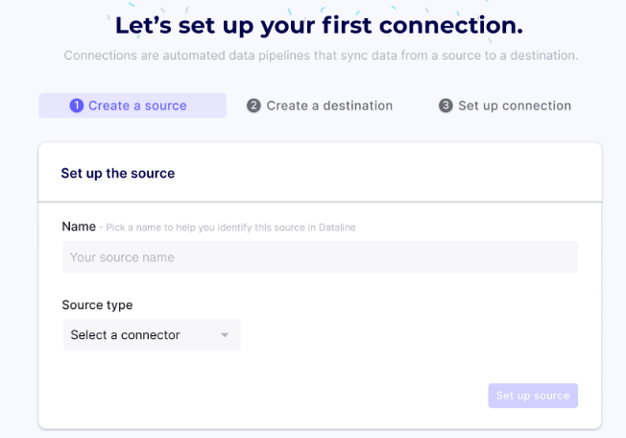
Postgres Replication
Let's see how you can spin up a local instance of Airbyte and syncing data from one Postgres database to another.
First of all, make sure that Docker and Docker Compose installed. Then run the following commands:
Once you see an Airbyte banner, the UI is ready to go at http://localhost:8000/.
Set up your first connection:
Now you will see a wizard that allows you choose the data you want to send through Airbyte.

Slide 6
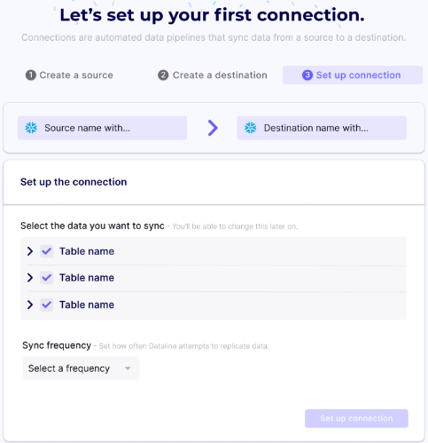
Postgres Replication Contd...
After adding the destination, you can choose what tables and columns you want to sync.
For this demo, we recommend leaving the defaults and selecting "Every 5 Minutes" as the frequency. Click Set Up Connection to finish setting up the sync.
References:
https://docs.airbyte.io/tutorials/postgres-replication#
2-set-up-your-first-connection

Slide 7
Solution2:
Connection is avaliable between edge and cloud:
1) When edge deploys an application then applcm will call the inventory module to update its database and if its success then update entry in local database with some flag as success.
2) When edge undeploys an application then applcm will call the inventory module to update its database and if its success then will delete entry in local database.
Connection is not avaliable between edge and cloud:
1) When edge deploys an application then applcm will call the inventory module to update its database but will fail because of connection failure and then update entry in local database with some flag as failure
2) Run a background process in applcm which checks for health check of inventory module, if health check is pass then run through the database look for failure rows and notify them to inventory and if its success then unsetting the failure to success in local database

Slide 8
Solution2 Contd...:
3) When edge undeploys an application then applcm will call the inventory module to update its database but will fail because of connection failure and then delete entry in local database and store appinstance id in list
4) Run a background process in applcm which checks for health check of inventory module, if health check is pass then run through the list for appinstance id and notify them to inventory and if its success then remove appinstanceid from list

Slide 9
Solution3:
Synchronizing Databases:
Implement Pub/Sub mechanism to synchronize two or more databases (Kafka)
Here lcmcontroller application publish appinstanceinfo record when application is deployed at edge
Inventory application receives this as an update (because inventory app is subscribed for that update)
The inventory application translates the row into the destination format and insert into database
By default, the Inventory subscriber consumes all existing records in the kafka and listens for any new incoming rows. Can start with migrating the current data and then keep the service running to keep both databases up to date.

Slide 10
Solution3 Contd:
When lcmcontroller application publish appInstance id when application is undeployed at edge
Inventory application receives this as an update (because inventory app is subscribed for that update)
The inventory application translates the row into the destination format and then delete it from database based on appInsid.

Slide 11
Solution4:
Provide a button in mecm edge portal to synchronize the databases manually.
Prerequisite:
There is a connection between cloud and edge when user/adminstrator is manually synchronizing the databases
Implementation:
When edge deploys an application then applcm will call the inventory module to update its database but will fail because of connection failure and then update entry in local database with some flag as failure
When edge undeploys an application then applcm will call the inventory module to update its database but will fail because of connection failure and then delete entry in local database and store appinstance id in list

Slide 12
Solution4 Contd:
Lcmcontroller reads all failure records from edge database and will send to inventory module to update in center database (Instantiation)
Lcmcontroller process the list of appinstanceids and will send to inventroy module to delete the records from center database(termination)

